Slide 1
Lecture 22: Machine Translation: Syntax and Neural
USC VSoE CSCI 544: Applied Natural Language Processing
Jonathan May -- 梅約納
November 15, 2017
slides from Philipp Koehn, Adam Lopez, Chris Manning, Richard Socher

Slide 2
Syntax: Add more linguistic information

Slide 3
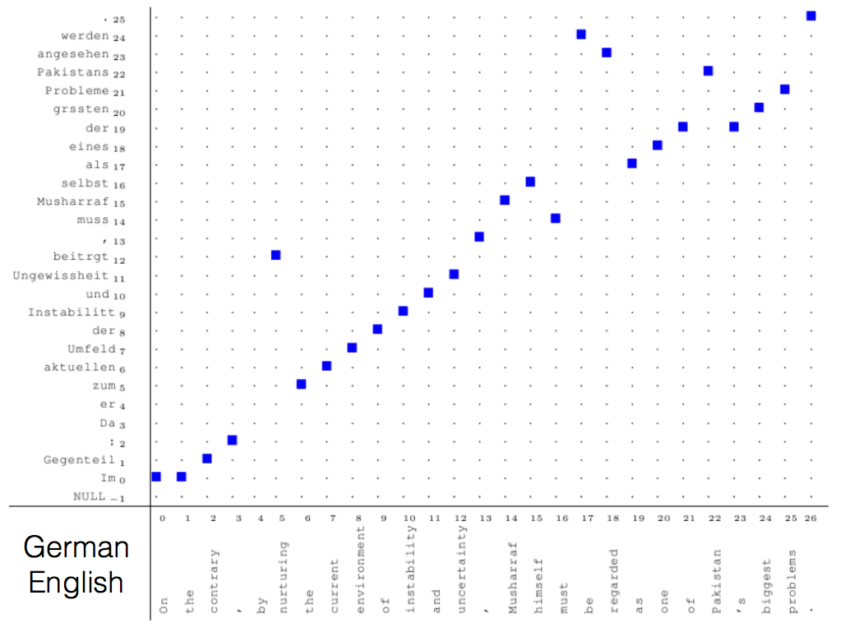

Slide 4
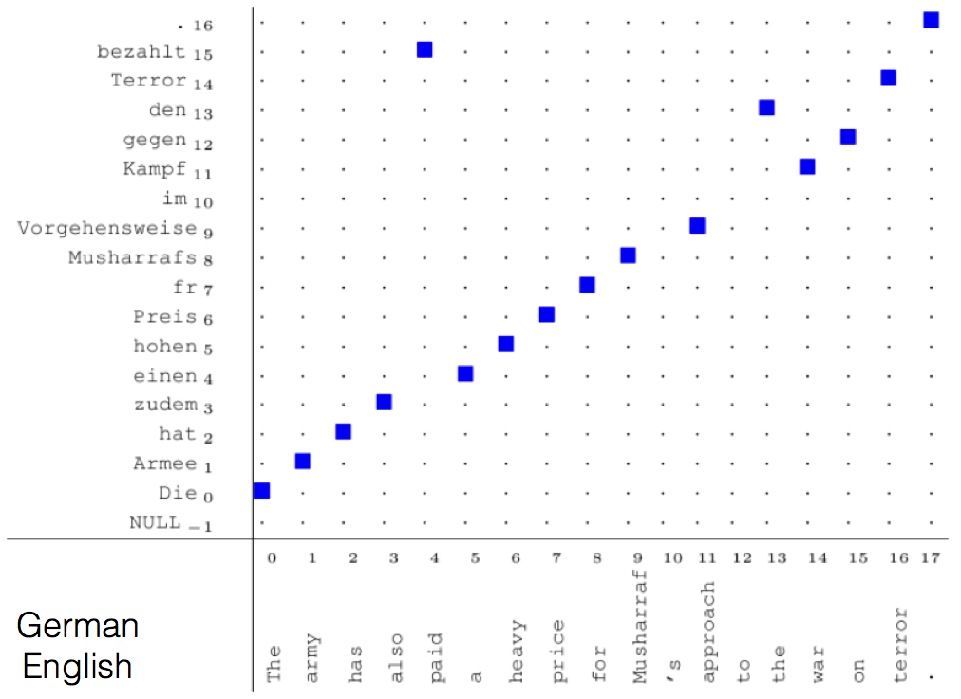

Slide 11
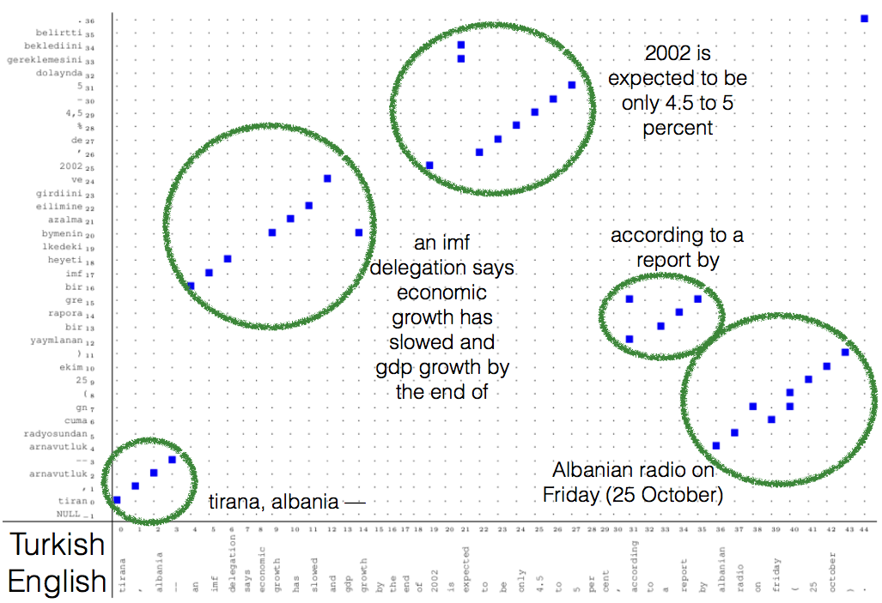

Slide 12
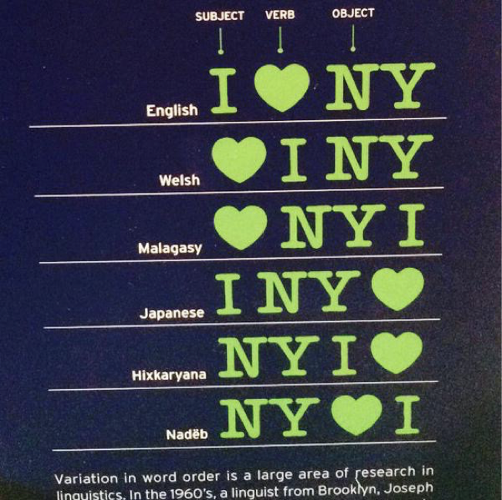
Relative Regularities Between Languages

Slide 13
Relative Regularities Between Languages

Slide 14
It's tough to capture this with PBMT
Need to do a very good job of scoring permutation
In practice, PBMT between very different word orders doesn't work well
It would be nice if we could capture linguistic regularities between languages

Slide 15
Interlingua
Syntactic Transfer
Analysis (parsing)
Generation
(read off leaves)
Source
Target

Slide 16
Hierarchical language structure can be induced from word alignments

Slide 17
Note: we now start calling these
pairs "rules" instead of "phrases"
since they won't simply be phrases any more

Slide 22
X Y
=
Y of X

Slide 23
What About Explicit Syntax?
Extract if licensed by alignment
and licensed by both trees
If you have parsers, you can enforce the replacements to be syntactically well-formed

Slide 25
Problems with Syntax on Source and Target
Too restrictive – far fewer rules can be extracted
We don't always have good syntactic parsers for both languages
We do have them for English
Solution: Syntax on only one side of the data (typically the English side)
Intuition: when translating, input already has correct syntax; only need to worry about the output
Algorithm due to (Galley, Hopkins, Knight, Marcu, 2004) ('GHKM')
Find rules that obey alignment and syntactic constraints
Find 'tiling' of tree, string, alignment for rules with variable positions
equivalent to 'subtracting' smaller rules from larger rules

Slide 31
minus
"If you have translated a subtree rooted in PRP,
you can insert "to" and make a PP"

Slide 32
"If you have translated a subtree rooted in DT followed
by a subtree rooted in NNS, you have translated a subtree
rooted in NP"

Slide 33
"If you have translated a subtree rooted in PP followed
by a subtree rooted in NP, followed by the word aushändigen,
you can translate "passing on" + the PP translation + the NP"

Slide 37
Decoding

Slide 38
It's a lot like parsing, with extra annotation that explains how the English side is built
match foreign side,
store nonterminal
in appropriate cell,
build tree from english
side
sie
will
eine
Tasse
Kaffee
trinken
0
1
2
3
4
5
6

Slide 39
It's a lot like parsing, with extra annotation that explains how the English side is built
0-1 PRO
sie
will
eine
Tasse
Kaffee
trinken
0
1
2
3
4
5
6

Slide 40
It's a lot like parsing, with extra annotation that explains how the English side is built
0-1 PRO |  |  |  | 4-5 NN
sie
will
eine
Tasse
Kaffee
trinken
0
1
2
3
4
5
6

Slide 41
It's a lot like parsing, with extra annotation that explains how the English side is built
0-1 PRO |  |  |  | 4-5 NN | 5-6 VB
sie
will
eine
Tasse
Kaffee
trinken
0
1
2
3
4
5
6

Slide 42
It's a lot like parsing, with extra annotation that explains how the English side is built
find the words and a completed NN
0-1 PRO |  |  |  | 4-5 NN | 5-6 VB
sie
will
eine
Tasse
Kaffee
trinken
0
1
2
3
4
5
6

Slide 43
It's a lot like parsing, with extra annotation that explains how the English side is built
find the words and a completed NN
 |  | 2-5 NP
0-1 PRO |  |  |  | 4-5 NN | 5-6 VB
sie
will
eine
Tasse
Kaffee
trinken
0
1
2
3
4
5
6
note: for
n³ performance like CKY, need to binarize; not shown here

Slide 44
It's a lot like parsing, with extra annotation that explains how the English side is built
Note reordering!
 |  | 2-5 NP
0-1 PRO |  |  |  | 4-5 NN | 5-6 VB
sie
will
eine
Tasse
Kaffee
trinken
0
1
2
3
4
5
6

Slide 45
It's a lot like parsing, with extra annotation that explains how the English side is built
 | 1-6 VP
Note reordering!
 |  | 2-5 NP
0-1 PRO |  |  |  | 4-5 NN | 5-6 VB
sie
will
eine
Tasse
Kaffee
trinken
0
1
2
3
4
5
6

Slide 46
It's a lot like parsing, with extra annotation that explains how the English side is built
 | 1-6 VP
 |  | 2-5 NP
0-1 PRO |  |  |  | 4-5 NN | 5-6 VB
sie
will
eine
Tasse
Kaffee
trinken
0
1
2
3
4
5
6

Slide 47
It's a lot like parsing, with extra annotation that explains how the English side is built
0-6 S
 | 1-6 VP
 |  | 2-5 NP
0-1 PRO |  |  |  | 4-5 NN | 5-6 VB
sie
will
eine
Tasse
Kaffee
trinken
0
1
2
3
4
5
6

Slide 48
Neural: Remove all linguistic information

Slide 50
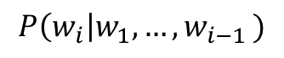
Recall: RNNs
$$P\left(w_{i}\right|w_{1}, {…,w}_{i−1})$$
w_{i-1}

Slide 51
h_{"I"}
P(w_{i}= ... | "I")
=P(w_{i}= ... | h_{"I"})
"I"
Sentence = "I threw the ball"

Slide 52
h_{"I threw"}
P(w_{i}= ... | I threw)
h_{"I"}
=P(w_{i}= ... | h_{"I threw"} )
"threw"
Sentence = "I threw the ball"

Slide 53
h_{"I threw the"}
P(w_{i}= ... | I threw the)
h_{"I threw"}
=P(w_{i}= ... | h_{"I threw the "} )
"the"
Sentence = "I threw the ball"

Slide 54
h_{"I threw the ball"}
P(w_{i}= ... | I threw the ball)
h_{"I threw the"}
=P(w_{i}= ... | h_{"I threw the ball "} )
P(w_{i}= STOP | I threw the ball)
"ball"
Sentence = "I threw the ball"

Slide 55
Unrolled View of RNN
I
threw
the
ball
<EOS>
<BOS>

Slide 56
Unrolled View of RNN (2-layer)
I
threw
the
ball
<EOS>
<BOS>

Slide 57
RNN when input is given (no need to consult output layer)
<BOS>
I
threw
the
ball
<EOS>

Slide 69
Neural MT is a fast-evolving area
RNN-free approaches
Character-based models to avoid out-of-vocabulary issues
Unified encoder-decoder for 'zero shot' translation
Translation without parallel data

Slide 70
Challenges
Data size important: NMT needs more data than non-neural SMT before it is competitive
Domain issues: NMT can go spectacularly wrong when domain suddenly shifts
Noise: NMT is more bothered by noisy training data (non-parallel, non-fluent) than non-neural SMT
Evaluation may be fooled by fluency in lieu of adequacy
big chunks of meaning can be skipped; new meaning can be inserted

Slide 72
Domain Mismatch
green = NMT
blue = PBMT
Koehn and Knowles, '17

Slide 75
Solutions to these problems: Use best of both worlds
Add NMT scores as a feature in SMT
Train NMT to directly predict word alignments
Add coverage vector to NMT to ensure the source is all translated
Train NMT to generate syntax trees with translation
Learn to choose between SMT/NMT output
Allow hand-crafted rules to direct NMT/SMT decoding for certain parts of a translation
...
It's still a wide open field!

Slide 76
Summary
Machine Translation is the oldest NLP application and also one of the most active
Old days: lots of linguistic insight and hand crafted rules
90s: throw away linguistics, rely on corpora and 'pure' models
early 2000s: a bunch of engineering, less 'pure' (discriminative) models
mid 2000s: add linguistics, even more engineering
2014: throw away all that, rely just on data and 'pure' models
2017+: old stuff creeping back in?

